Slide 1
Introductory Statistics with R/Python
Part 2: Correlation & Linear Regression

Slide 2
Correlation

Slide 3
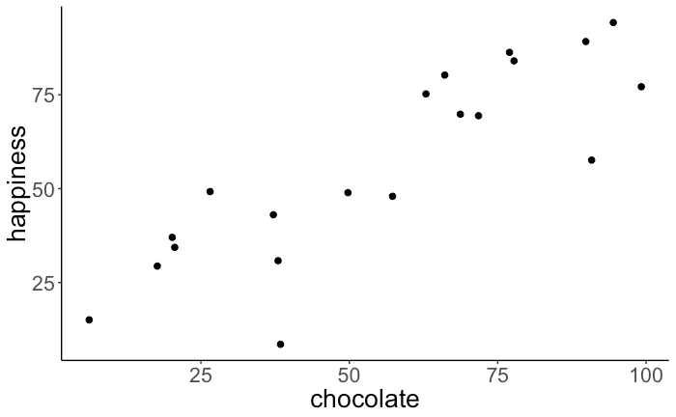
How would you characterize the relationship between x and y by a single number?
Correlation: a measure of the relationship between two variables

Slide 4
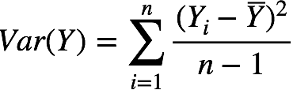
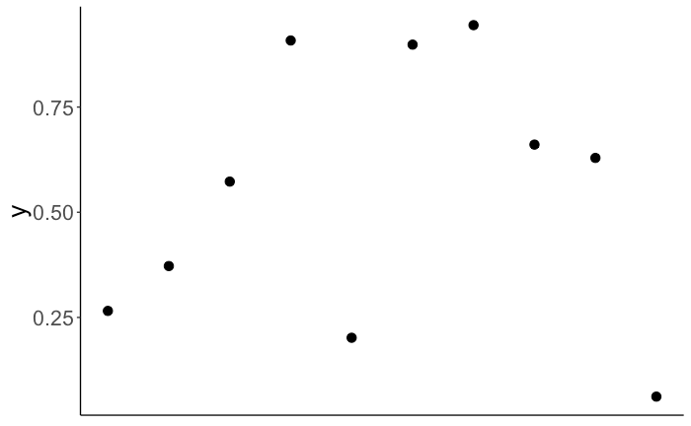
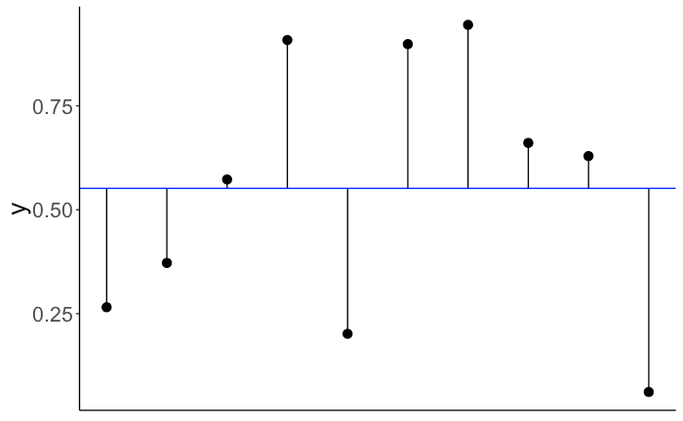
Variance
aka: sum of squared errors
In other words, how well does the mean describe the data?

Slide 5
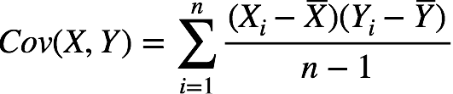
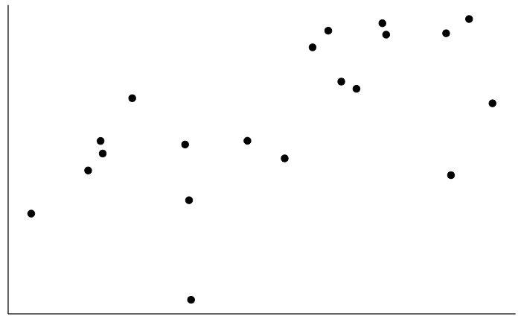
Co-Variance

Slide 6
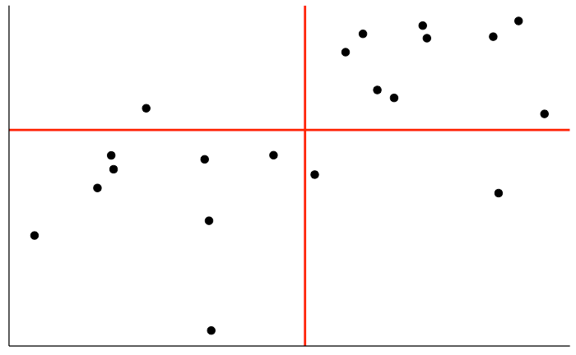
Covariance
Which quadrants represent positive covariance versus negative covariance?

Slide 7
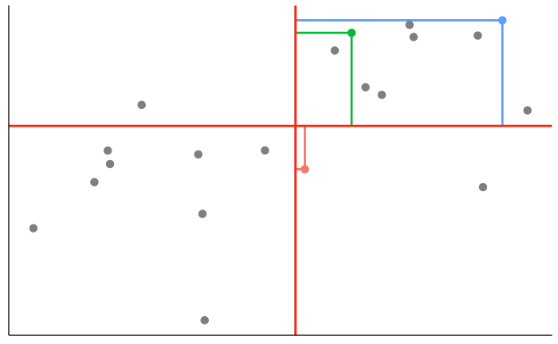
Covariance
medium
value
large
value
negative values
positive values
small
value
positive values
negative values
beware of outliers

Slide 8
Covariance
Problem: this depends on the scale of the variables
ie., bigger variables have more influence!

Slide 9
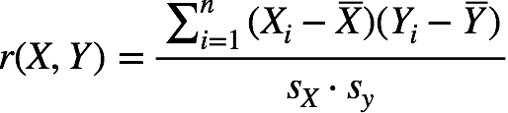
Covariance
Problem: this depends on the scale of the variables
Pearson Correlation
standardized covariation
(dividing by the standard deviations)

Slide 10
Properties of the Pearson correlation
standardized: -1 ≤ r ≤ 1
scale independent (for both X and Y)
commutativity: r(X, Y) = r(Y, X)
sign determines the direction of dependence
captures linear dependence only
Remember! correlation is not causation

Slide 11
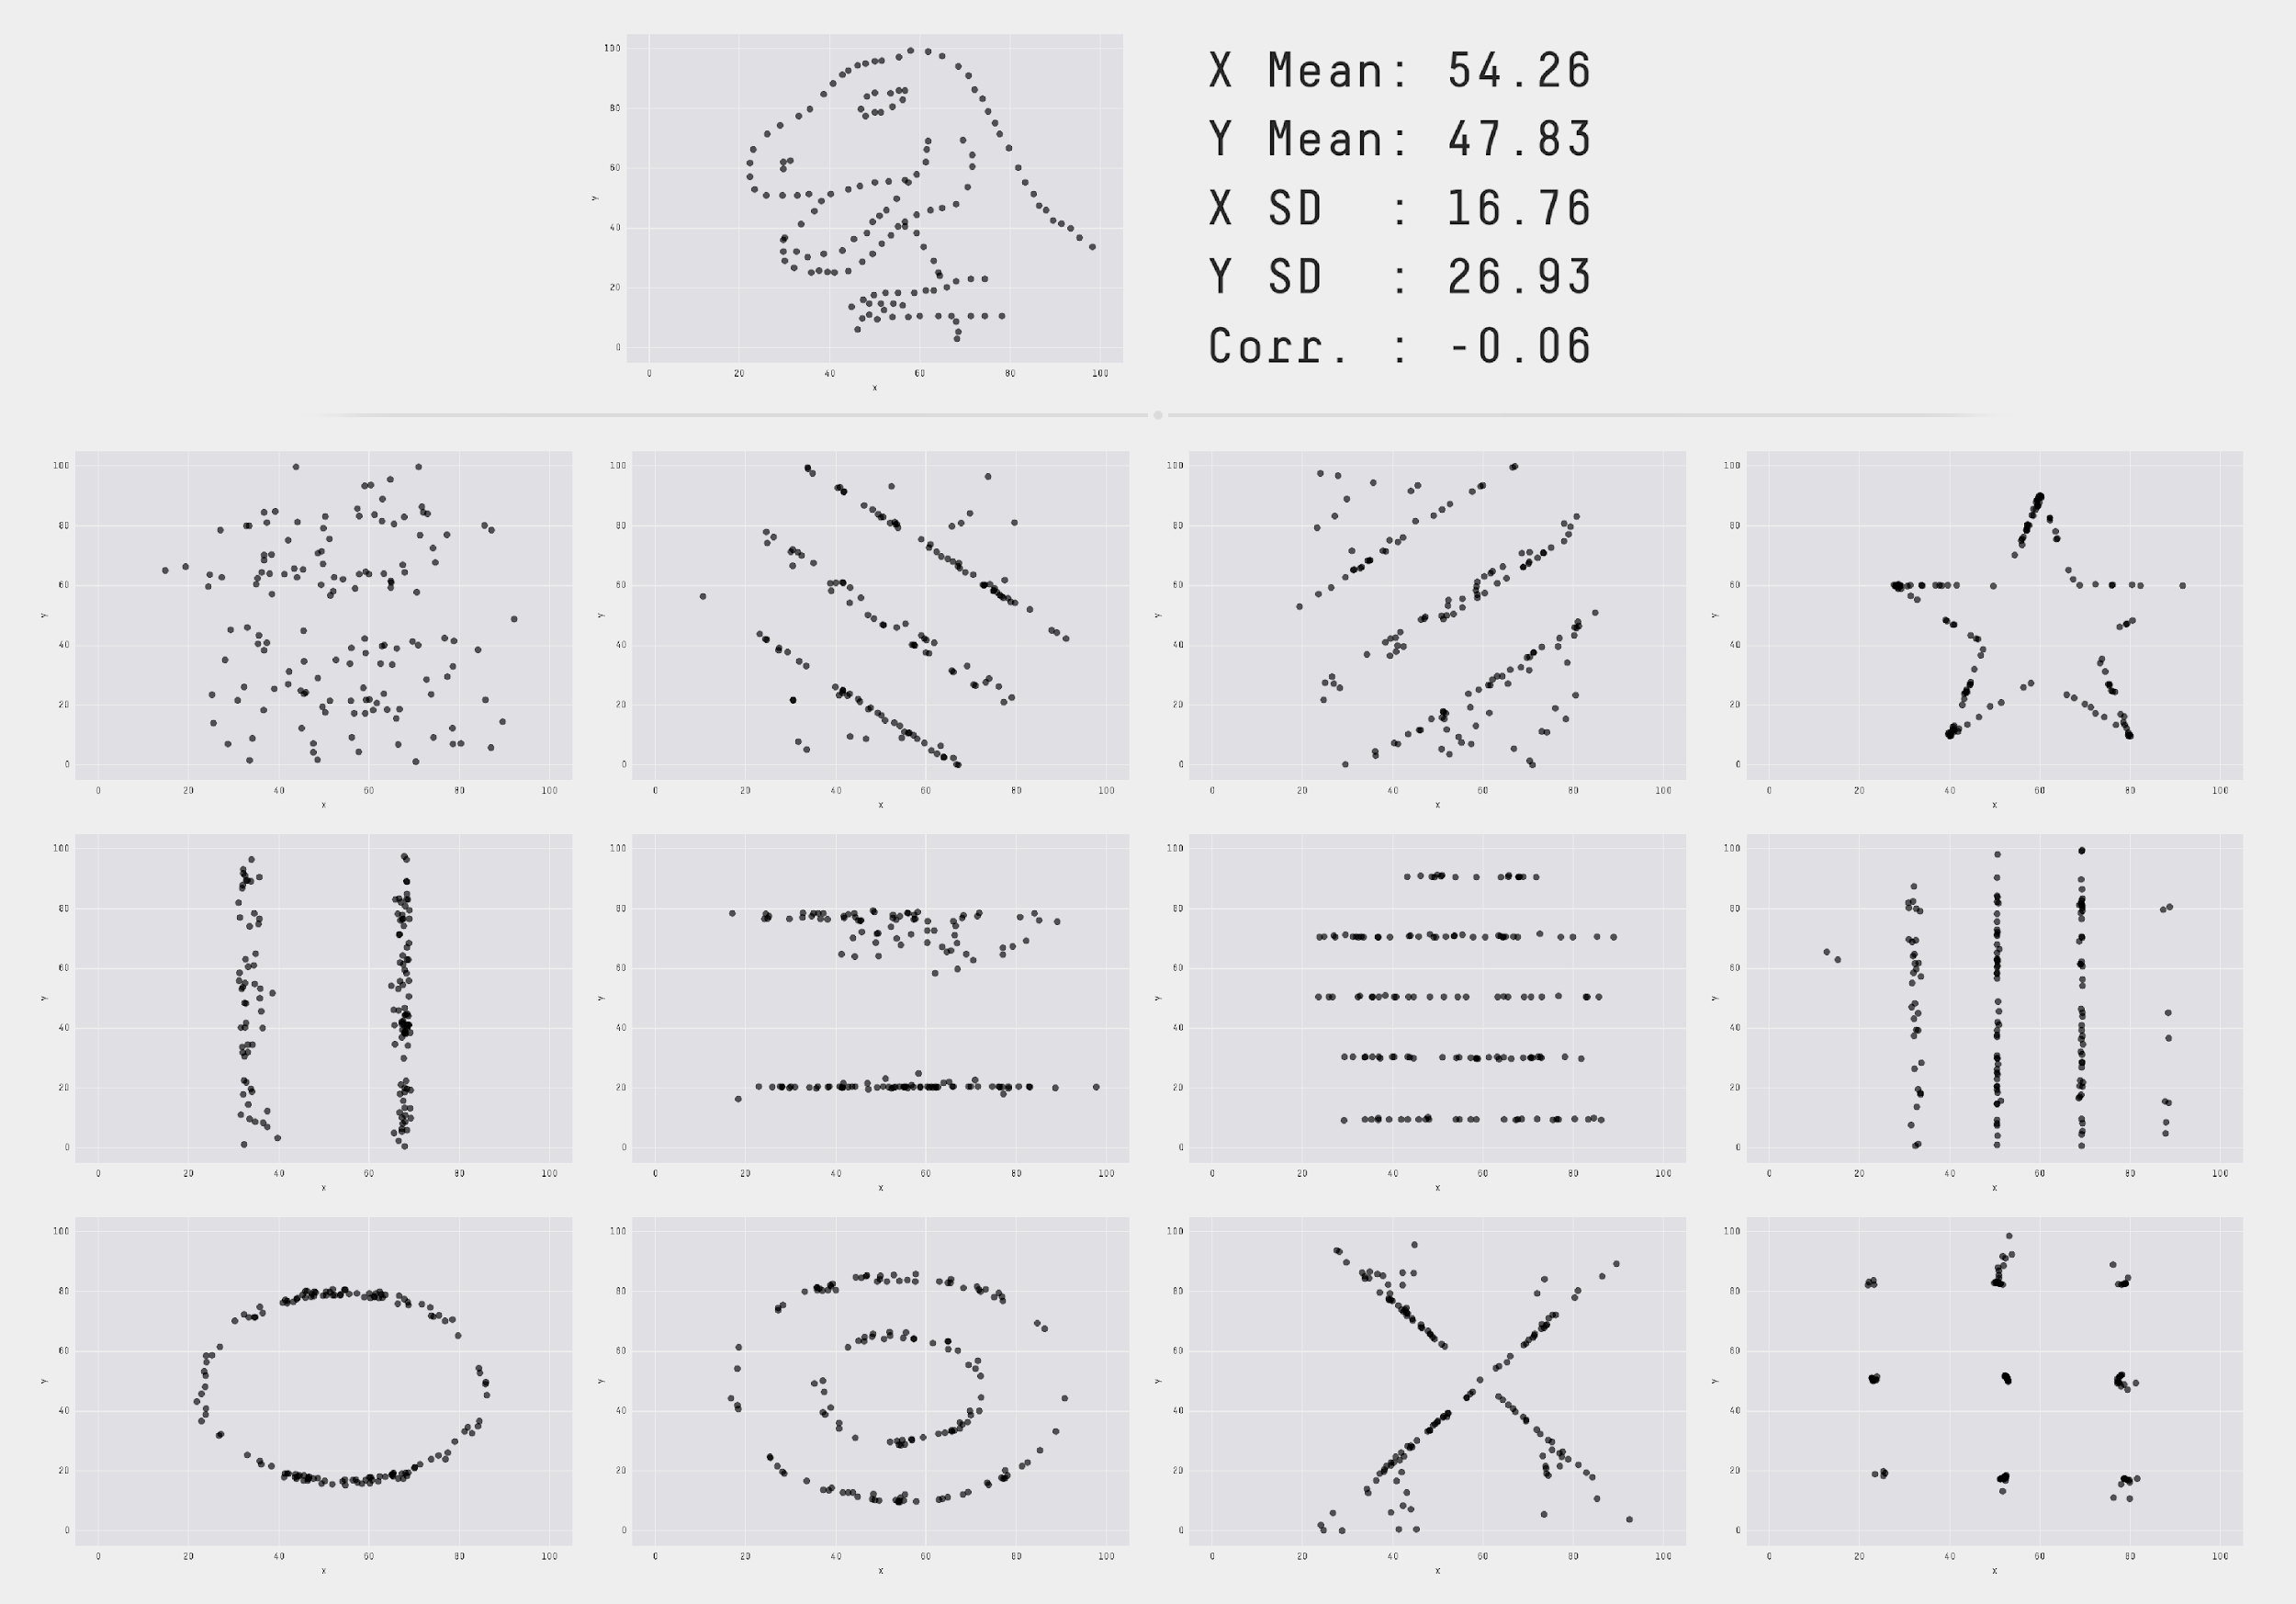
Be careful about interpreting correlations!
always visualize the data ...

Slide 12
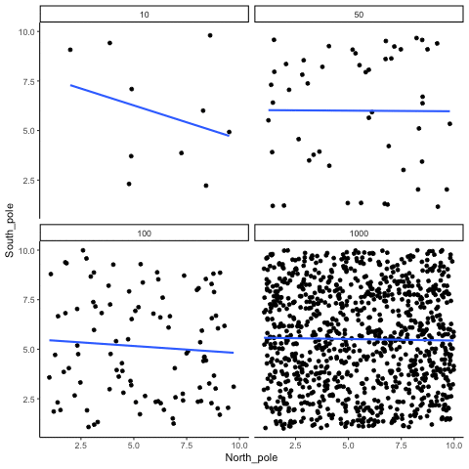
Beware of small sample sizes!

Slide 13
R: cor(x,y)
r = cor(x, y, method = c(“pearson”, “kendall”, “spearman”))
r = .61
Also check out cor.test for significance testing!

Slide 14
Linear Regression

Slide 15



Linear model: Simple regression
Data = Model + Error
the model is a linear combination of predictors

Slide 16




H₀: Chocolate consumption and happiness are unrelated.
H₁: Chocolate consumption and happiness are related.
Model C
Model A
chocolate consumption
and

Slide 17
The general procedure
Define H₀ as Model C (compact) and H₁ as Model A (augmented)
Fit model parameters to the data
Calculate the proportional reduction of error (PRE) in our sample
Decide whether the augmented model is worth it by comparing the observed PRE in our sample to the sampling distribution of PRE (assuming that H₀ is true)

Slide 18
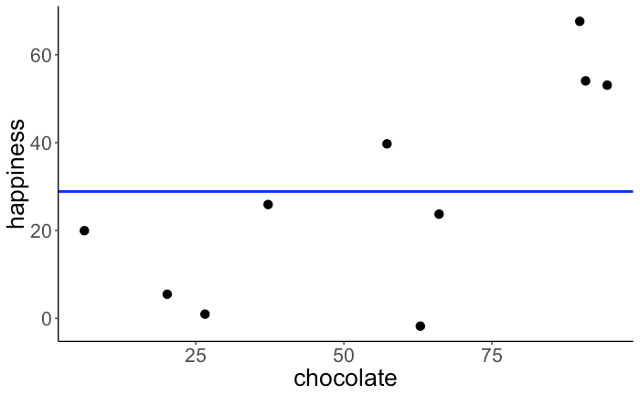
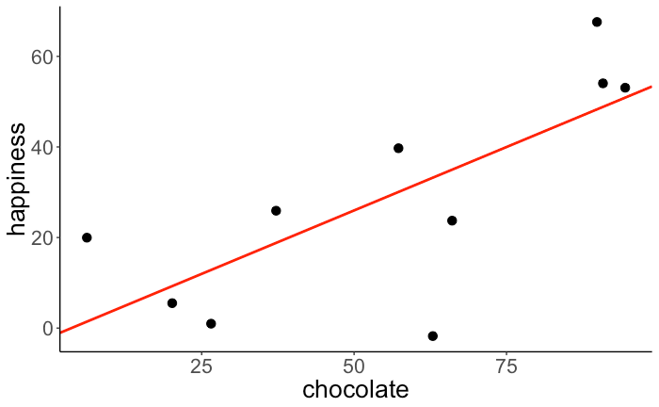

H₀: Chocolate consumption and happiness are unrelated.
H₁: Chocolate consumption and happiness are related.
Model C
Model A
Model prediction
Model prediction
Fitted model
Fitted model

Slide 19

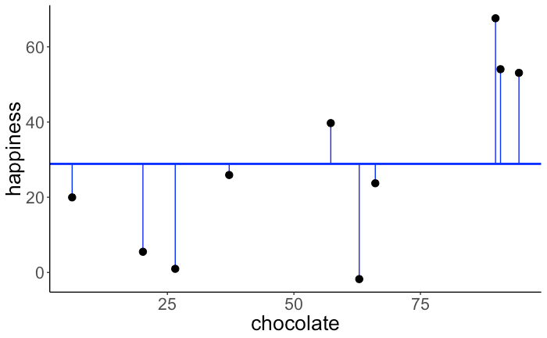
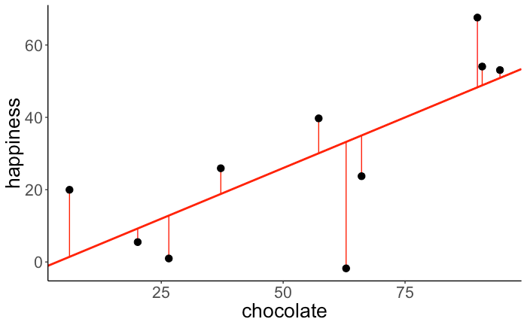

Calculate PRE
Both models were fit to minimize the sum of squared errors
OLS = Ordinary least squares regression
Sum of squared errors
Sum of squared errors
SSE(C) = 5215.016
SSE(A) = 2396.946
The augmented model reduces the error by 54%.

Slide 20
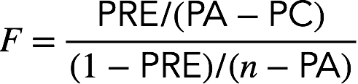
Decide whether it's worth it
more likely to be worth it if:
PRE is high
the number of additional parameters in model A compared to model C is low
To compute the F statistic, we need:
PRE
number of parameters in Model C (PC) and Model A (PA)
number of observations n
difference in parameters between models A and C
number of observations vs. parameters in Model A

Slide 21
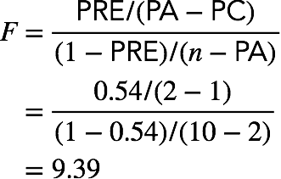
Decide whether it's worth it
To compute the F statistic, we need:
PRE = 0.54
PC = 1 and PA = 2
n = 10
There is a significant relationship between chocolate consumption and happiness
F(1, 8) = 9.39, p = .0154.

Slide 22

Linear model
fit = lm(balance ~ 1 + income, data = df.credit)
outcome
intercept
predictor
data
(doesn't need to be specified explicitly)

Slide 23
lm()
fit = lm(balance ~ 1 + income, data = df.credit)
print(fit)
Call:
lm(formula = balance ~ 1 + income, data = df.credit)
Coefficients:
(Intercept) income
246.515 6.048
parameter estimates

Slide 24
summary()
lm(balance ~ 1 + income, data = df.credit) %>%
summary()
Call:
lm(formula = balance ~ 1 + income, data = df.credit)
Residuals:
Min 1Q Median 3Q Max
-803.64 -348.99 -54.42 331.75 1100.25
Coefficients:
Estimate Std. Error t value Pr(>|t|)
(Intercept) 246.5148 33.1993 7.425 6.9e-13 ***
income 6.0484 0.5794 10.440 < 2e-16 ***
---
Signif. codes: 0 ‘***’ 0.001 ‘**’ 0.01 ‘*’ 0.05 ‘.’ 0.1 ‘ ’ 1
Residual standard error: 407.9 on 398 degrees of freedom
Multiple R-squared: 0.215, Adjusted R-squared: 0.213
F-statistic: 109 on 1 and 398 DF, p-value: < 2.2e-16

Slide 25
Hypothesis test
Model C
Model A
fit_c = lm(formula = balance ~ 1,
data = df.credit)
fit_a = lm(formula = balance ~ 1 + income,
data = df.credit)
anova(fit_c, fit_a)
Analysis of Variance Table
Model 1: balance ~ 1
Model 2: balance ~ 1 + income
Res.Df RSS Df Sum of Sq F Pr(>F)
1 399 84339912
2 398 66208745 1 18131167 108.99 < 2.2e-16 ***
---
Signif. codes: 0 ‘***’ 0.001 ‘**’ 0.01 ‘*’ 0.05 ‘.’ 0.1 ‘ ’ 1

Slide 26
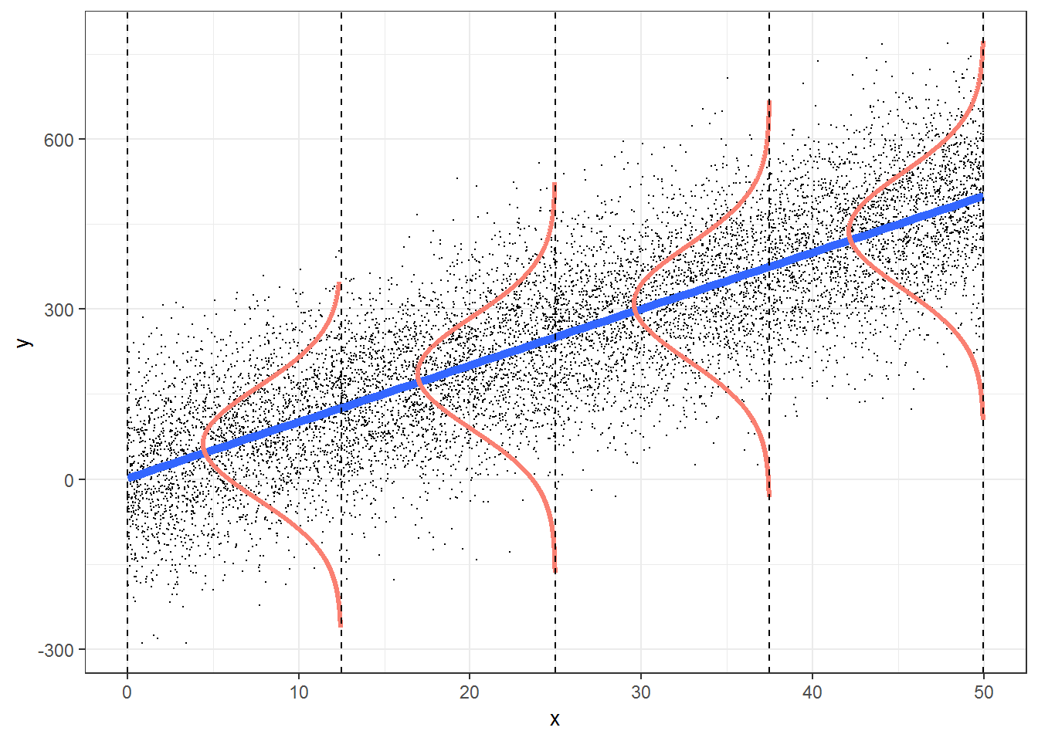
Model assumptions
independent observations
Y is continuous
errors are normally distributed
errors have constant variance
error terms are uncorrelated

Slide 27



Try it yourself!
Q1: What is the relationship between age and optimism?
Q2: How do age and party affiliation contribute to optimism?

Slide 28
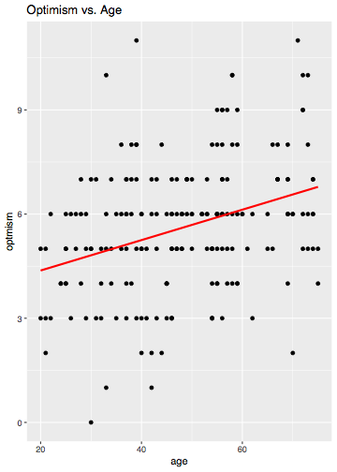
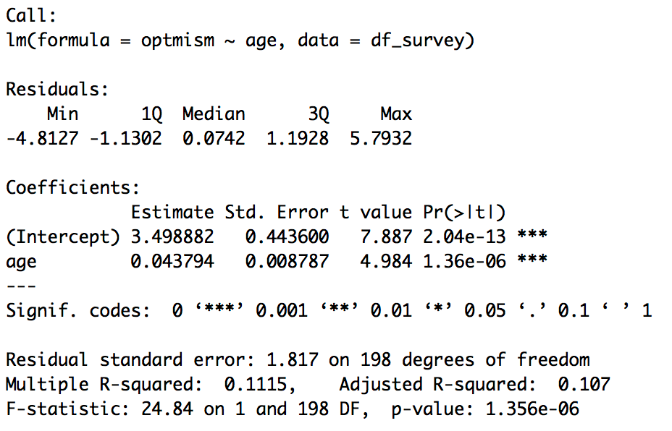
What did you find?
Q1: What is the relationship between age and optimism?

Slide 29
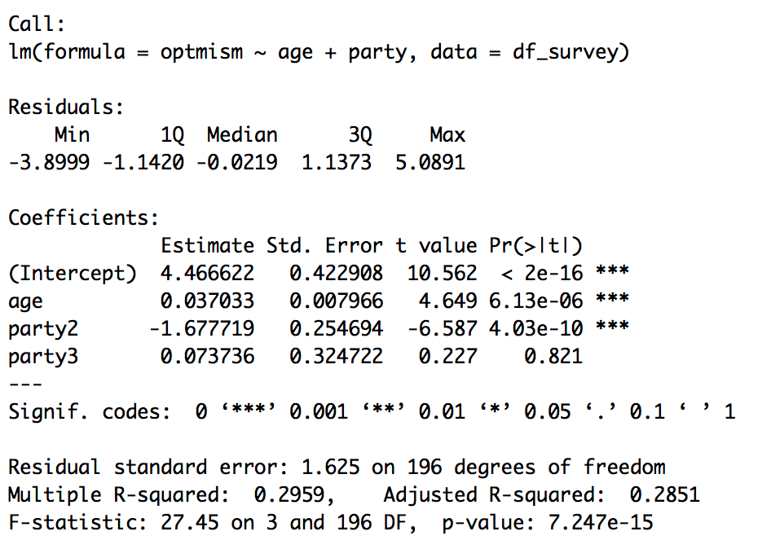
What did you find?
Q2: How do age and party affiliation contribute to optimism?

